Slide 1
Voice Authentication
Problem Statement
Authentication measures of Caller ID / PIN (personal identification numbers) / Security Questions / Device Signatures are sometime inadequate and intrusive. Identify creative methods of Customer Authentication which can be used on various channels. This should be done without deteriorating the customer experience.

Slide 2
Voice Biometrics Verification
Once the user’s voiceprint is captured and stored in the system, it is used to verify the user. During the authentication process, the user needs to talk. The voice biometrics system captures the voiceprint and verifies whether the voiceprint matches with the template on its database.
Types of Voice Biometrics Authentication
Active Voice Biometrics
Passive Voice Biometrics
Verification Parameters:
Time taken to authenticate
Data Volume
Security

Slide 3
Technical skills
Technology needs to be implemented for Voice biometric verification
Front end Technical skills
Angular
Wpf
Back end Technical Skills
Asp.net core web api,C#
Microservices
Speech Service API
Language API
Decision API
Azure Cognitive Services(AI)
Azure Cosmo DB
Blob storage
Hadoop/Big Data(Optional)

Slide 4
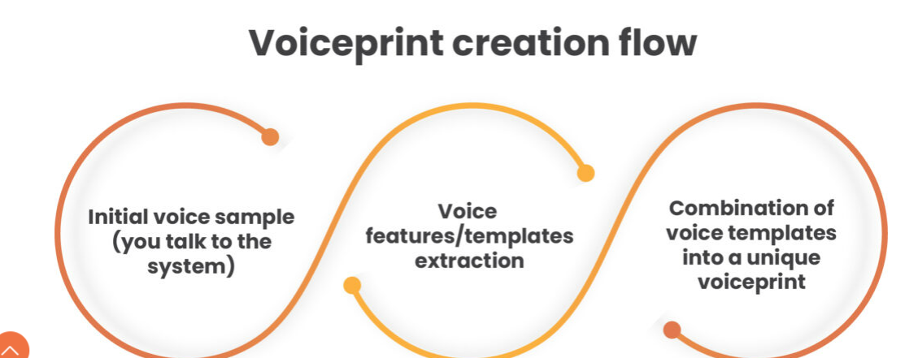
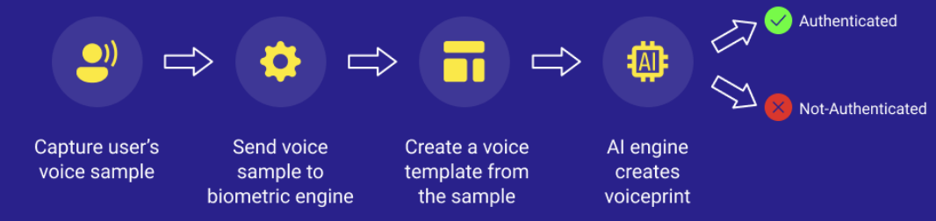
How does voice biometrics work?

Slide 5
Speech Service
The Speech service provides speech-to-text and text-to-speech capabilities with an Azure Speech resource. You can transcribe speech to text with high accuracy, produce natural-sounding text-to-speech voices, translate spoken audio, and use speaker recognition during conversations.
Create custom voices, add specific words to your base vocabulary, or build your own models. Run Speech anywhere, in the cloud or at the edge in containers. It's easy to speech enable your applications, tools, and devices with the Speech CLI, Speech SDK, Speech Studio, or REST APIs.
Speech is available for many languages, regions, and price points.

Slide 6
Language APIs
Language service:
Azure Language service provides several Natural Language Processing (NLP) features to understand and analyze text.
Translator:
Translator provides machine-based text translation in near real time
Language Understanding LUIS
Language Understanding (LUIS) is a cloud-based conversational AI service that applies custom machine-learning intelligence to a user's conversational or natural language text to predict overall meaning and pull out relevant information..
QnA Maker
QnA Maker allows you to build a question and answer service from your semi-structured content.

Slide 7
Decision APIs
Anomaly Detector
Anomaly Detector allows you to monitor and detect abnormalities in your time series data.
Content Moderator
Content Moderator provides monitoring for possible offensive, undesirable, and risky content.
Personalizer
Personalizer allows you to choose the best experience to show to your users, learning from their real-time behavior.

Slide 8
Create a new Azure Cognitive Services resource
The multi-service resource is named Cognitive Services in the portal. The multi-service resource enables access to the following Cognitive Services:
Decision - Content Moderator
Language - Language, Translator
Speech - Speech

Slide 9
Voice Authentication Technical work flow
Authentication with User ID and Password with additional factor of voice authentication(MFA)
Micro services talks to each other while processing voice print into DB.
Voice print stored in Azure cosmo db /Blob/Hadoop for unstrutred data.
SSL layer with HTTP protocol communication with server
Scalability and consistency with Azure Data centers
Password
Verified
Multi factcor Authentication
Voice verification
Verified
User Interface Login
User Id
Azure Cosmo DB
Hadoop
Speech service api
Language API
Decision API
Azure AI
Blob

Slide 10
How does voice biometrics prevent fraud?
Armour365™
armour365™ is a language and text agnostic Voice Biometrics solution.
Since voice biometrics provides real-time voice authentication by comparing a saved voiceprint with that of the caller, it helps ratify a person’s identity. Many characteristics of the caller are analyzed before authentication. At Armour365™, we use more than 120-140 characteristics while creating a voiceprint. Since it has an anti-spoofing layer, even if the synthetic voice is used, it identifies the caller as fraud and shuts them down.

Slide 11
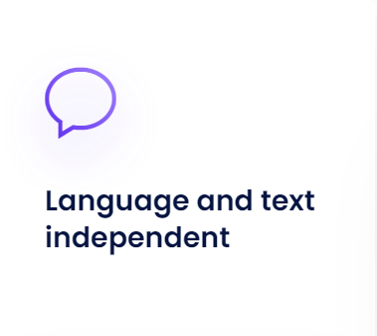
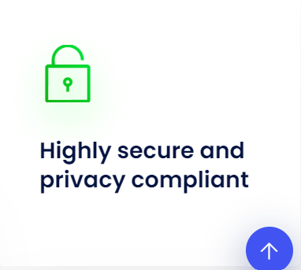

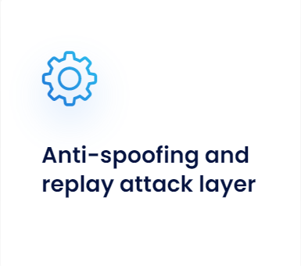
Armour365 Voice Biometrics

